Slide 2
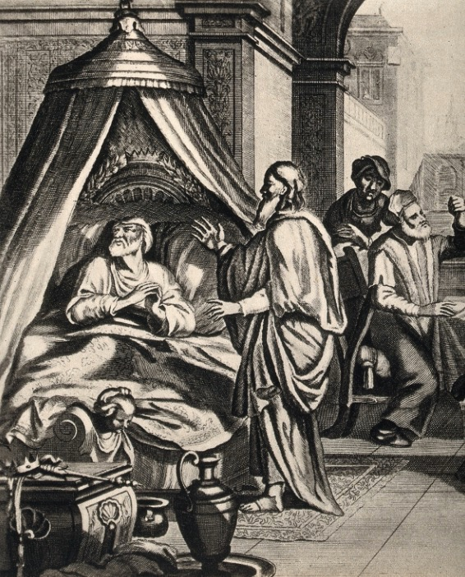
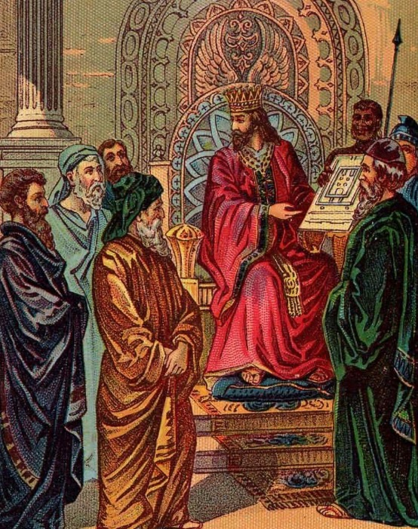
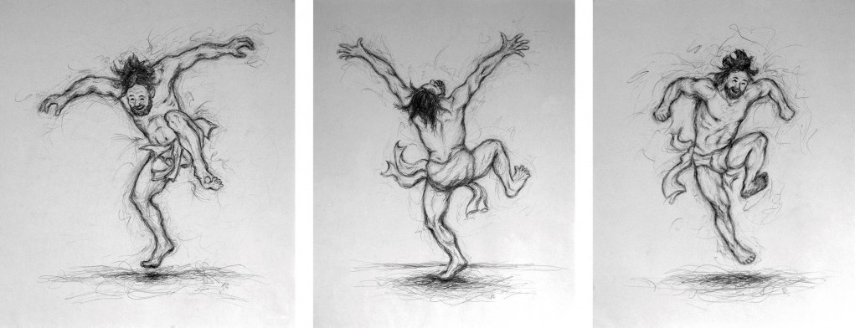
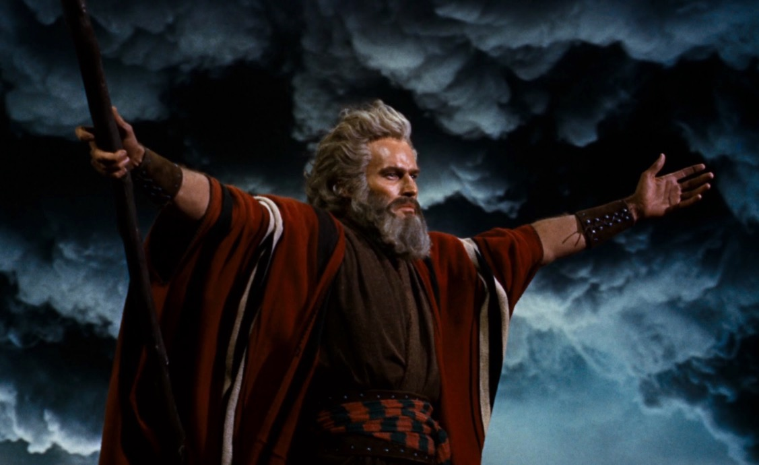

Slide 3
Thanks
Longing
Penitence
ANGER
Joy
Lament
Recall
Praise

Slide 4
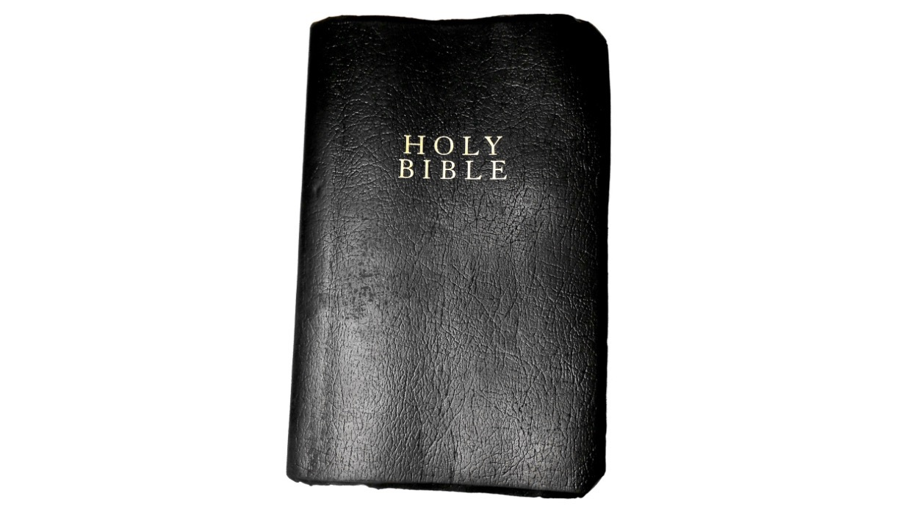
“I Love You!”,
etc.
(from God)

Slide 5
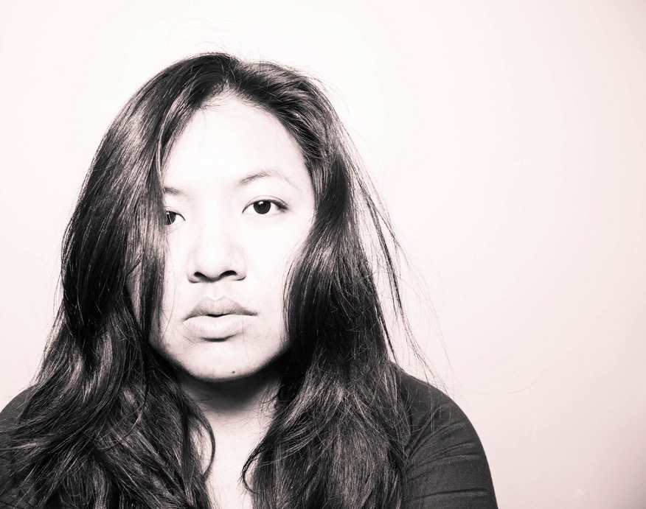
The Psalms
give us
WORDS

Slide 6
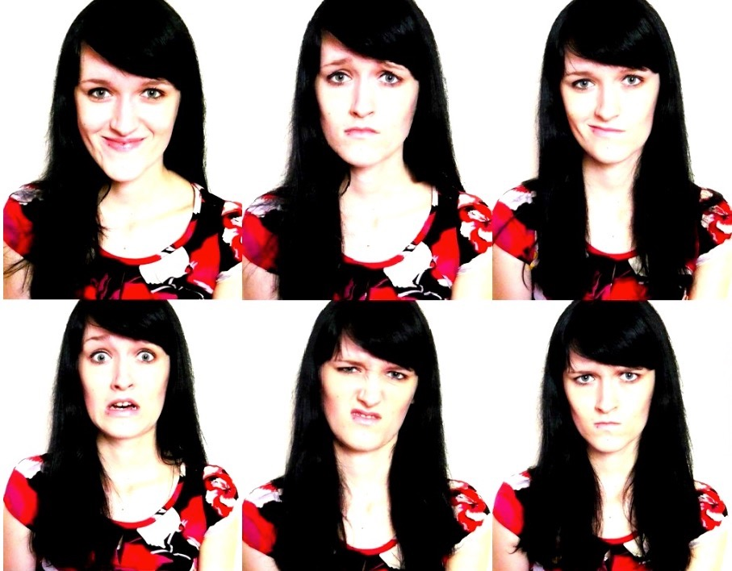

Slide 7
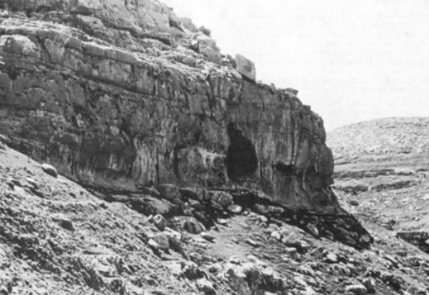
Bring them down in slow motion,
take them apart piece by piece.
Let all their mean-mouthed
arrogance catch up with them,
Catch them out and
bring them down
—every muttered curse
—every barefaced lie.
Finish them off in fine style!
Finish them off for good!
Then all the world will see
that God rules well in Jacob,
everywhere that God’s in charge.

Slide 8
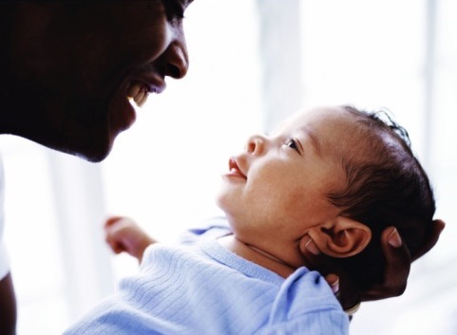
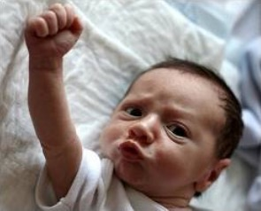
Liberate the language of the Psalms and give it the imaginative and free play that must have been intended. - Walter Brueggemann

Slide 9
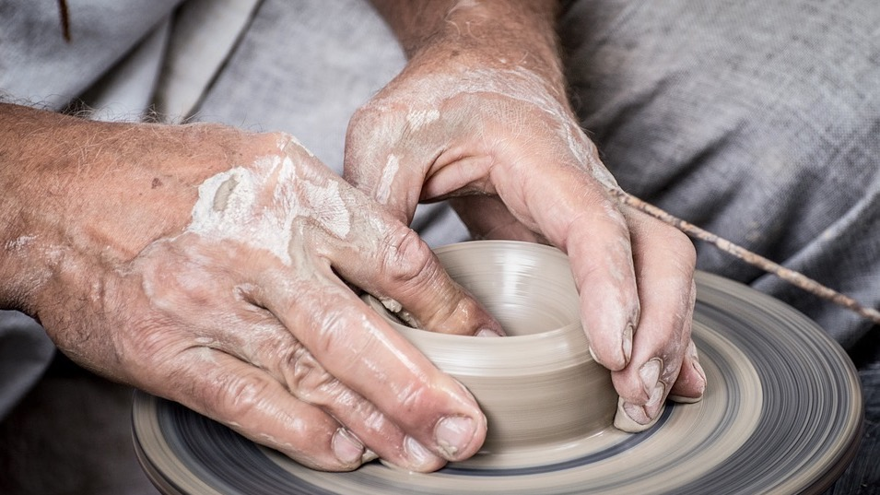
Praying the Psalms can form us

