Slide 1


Slide 2

POVERTY

Slide 3
Poverty (Mark 10:21)
“You lack one thing: go, sell all that you have and give to the poor, and you will have treasure in heaven; and come, follow me.”

Slide 4
Poverty (Mark 10:21)
“You lack one thing: go, sell all that you have and give to the poor, and you will have treasure in heaven; and come, follow me.”

Slide 5
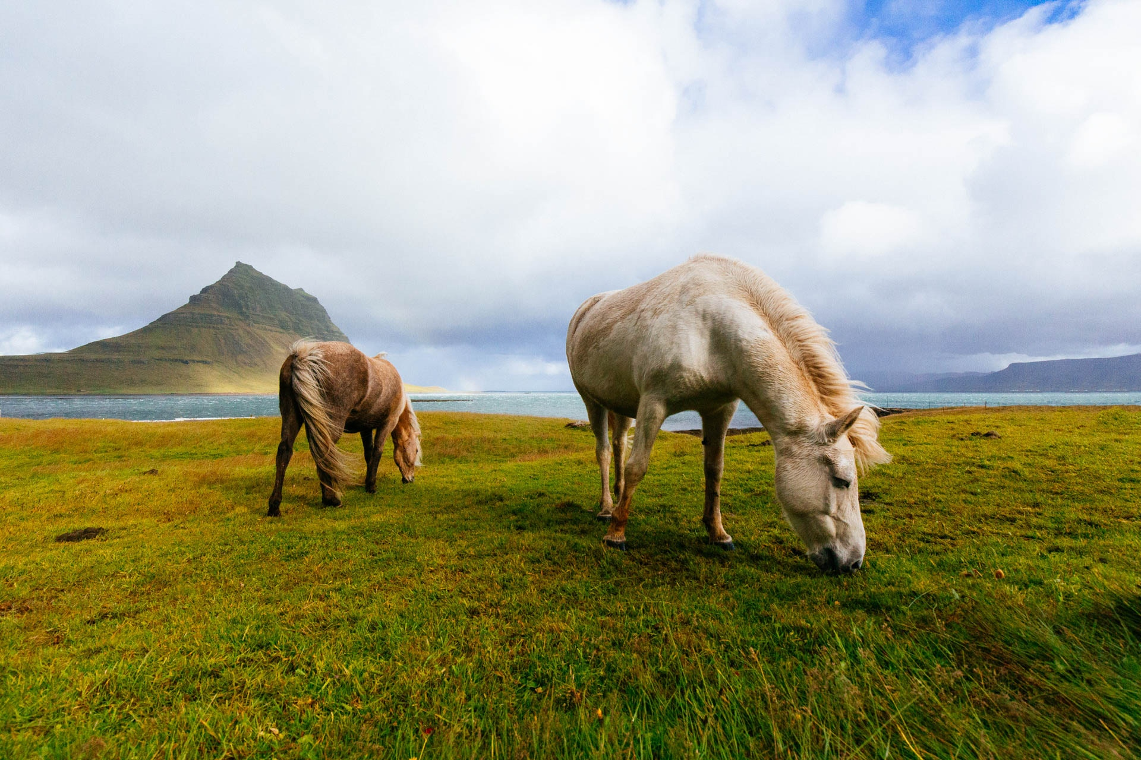

Slide 6

PROSPERITY

Slide 7
Prosperity (Mark 10:29-30)
“Truly, I say to you, there is no one who has left house or brothers or sisters or mother or father or children or lands, for my sake and for the gospel, ³⁰ who will not receive a hundredfold now in this time, houses and brothers and sisters and mothers and children and lands, with persecutions, and in the age to come eternal life.”

Slide 8
Prosperity (Mark 10:29-30)
“Truly, I say to you, there is no one who has left house or brothers or sisters or mother or father or children or lands, for my sake and for the gospel, ³⁰ who will not receive a hundredfold now in this time, houses and brothers and sisters and mothers and children and lands, with persecutions, and in the age to come eternal life.”

Slide 9


Slide 10
POVERTY PROSPERITY
POVERTY
Obstruction Blessing (Freedom) (Hope)
Sufficient Generous
Solidarity Support

